Slide 1

HIRING PROCESS ANALYTICS
JANUARY 2024
Done by B.Havilah

Slide 2
CONTENTS
Project Description | A brief overview of the project, its objectives
Approach | Project Execution: Techniques and Tools Employed
Tech-Stack used | Specifying the software I used and mentioning its purpose
Insights | Summary of the insights and knowledge I gained during the project
Results | Project Accomplishments: Enhancing the Understandings of Hiring Process Analytics
Drive link | Link of this project presentation and my excel workbook ,in which I did the analysis.
HIRING PROCESS ANALYTICS
JANUARY 2024

Slide 3

INTRODUCTION
Welcome to the 'Hiring Process Analytics' project, where we embark on a journey to unravel key insights into the dynamics of talent acquisition within a company. The hiring process is pivotal, and understanding trends such as rejections, interviews, job types, and vacancies can provide valuable insights for our hiring department.
HIRING PROCESS ANALYTICS

Slide 4

MY
APPROACH
HUMAN RESOURCES - PITCH DECK
JANUARY 2024

Slide 5
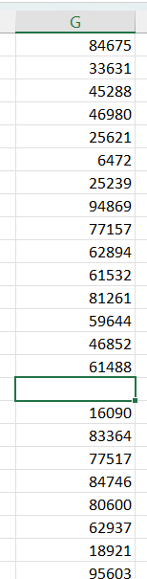
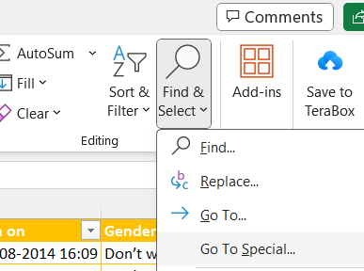
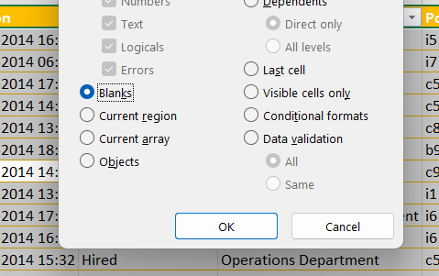
Handling Missing Data
Identifying and addressing missing values is vital for accurate analysis.
Employed strategies such as imputation or removal based on the nature of missing data.
Used , special option in Find & select icon at the home tab , and selected blank option to find out the null values.
I found a value which is in the 80th row displays as the G80 in the excel sheet.
Like this , I removed ”-” cells and blank cells in other columns also.
HIRING PROCESS ANALYTICS
JANUARY 2024

Slide 6
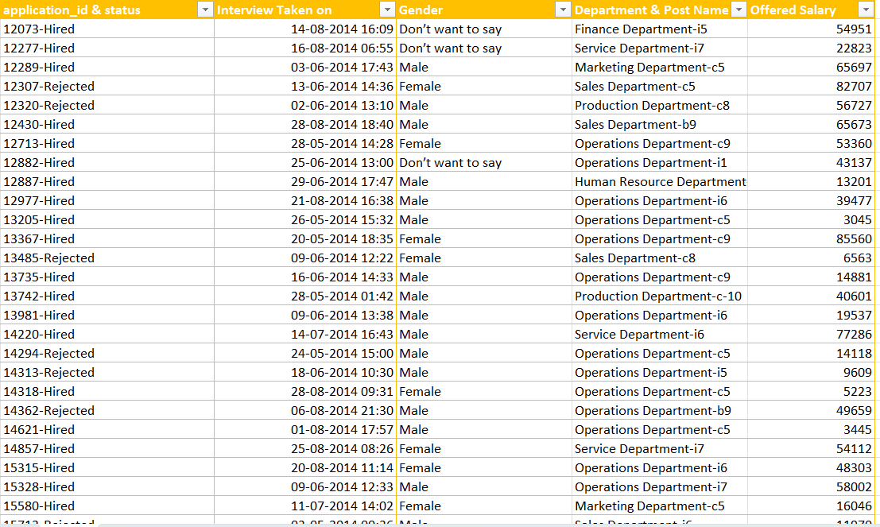
Clubbing Columns
Resultant data set after the clubbing the multiple columns to simply the analysis.
Used “=CONCAT” function , example: =CONCAT(A2:A7186,” “,B2:B7186) function to club the two columns A and B having rows from 2 to 7186.
HIRING PROCESS ANALYTICS
JANUARY 2024

Slide 7
Outlier Detection & Removing Outliers
Conducted outlier analysis to identify data points deviating significantly from the norm.
Decided on appropriate strategies for handling outliers, such as removal or replacement.
Used Statistical function like “QUARTILE” to identify the potential outliners.
Utilized Excel functions or formulas to calculate z-scores or IQR values for the relevant variables (e.g., salary) to identify data points that deviate significantly from the norm.
Decided whether to remove outliers or leave them in the dataset based on the specific context and goals of the analysis.
For the deletion of outliers, I used “DELETE” function to exclude the rows that meet certain criteria.
HIRING PROCESS ANALYTICS
JANUARY 2024

Slide 8
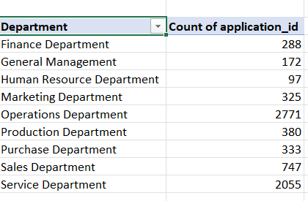
DATA SUMMARY
Here are some random charts generated from the given dataset.
These are done by Quick analysis in Excel.
HIRING PROCESS ANALYTICS
JANUARY 2024

Slide 9
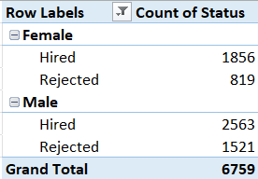
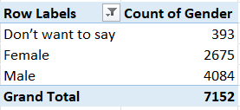
HIRING ANALYSIS
The hiring process involves bringing new individuals into the organization for various roles.
The bar chart and pivot tables are representing the Hiring analysis with Gender Distribution.
IN total, 1856 females and 2563 males were hired by the company.
819 females and 1521 males were rejected.
HIRING PROCESS ANALYTICS
JANUARY 2024

Slide 10
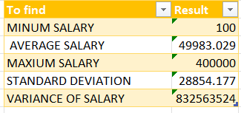
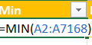

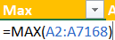
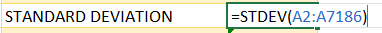

SALARY ANALYSIS
The average salary is calculated by adding up the salaries of a group of employees and then dividing the total by the number of employees.
Here, I used Functions for each row to represent minimum, maximum, average ,standard deviation and variance for the column of offered salary.
The functions are =AVERAGE(A2:A7186), =MAX(A2:A7186), =MIN(A2:A7186),
=STDEV(A2:A7186), =VAR.S(A2:A7186)
HIRING PROCESS ANALYTICS
JANUARY 2024

Slide 11
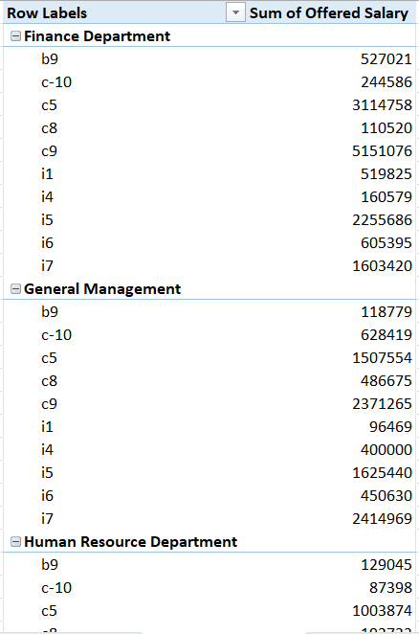
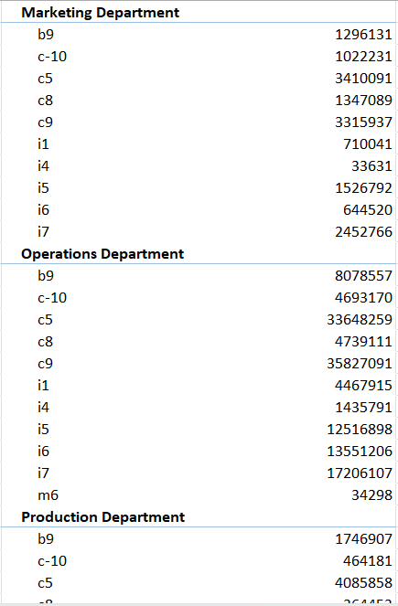
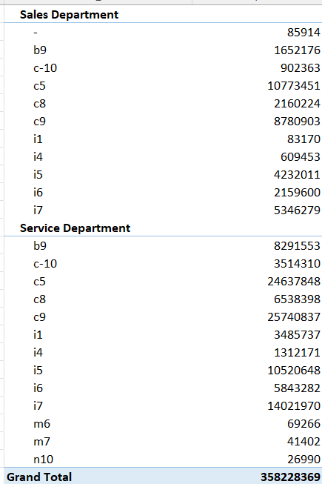
SALARY DISTRIBUTION
Class intervals represent ranges of values, in this case, salary ranges. The class interval is the difference between the upper and lower limits of a class.
Here, I represented the sum of offered salary for each post in different departments
I used pivot tables to analyze the data.
HIRING PROCESS ANALYTICS
JANUARY 2024

Slide 12
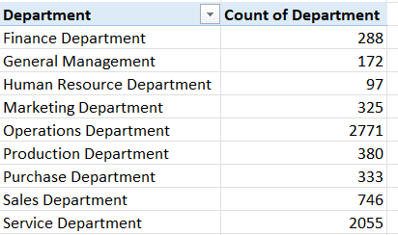
DEPARTMENT ANALYSIS
Visualizing data through charts and plots is a crucial part of data analysis.
I directly used the bar chart option from the Quick analysis which also gives the pivot table.
We can also use the “COUNTIF” function to count the people in a specific department.
Here, Operations Department” is the most counted with 2771.
HIRING PROCESS ANALYTICS
JANUARY 2024

Slide 13
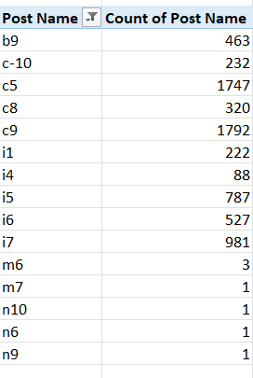
POSITION TIER ANALYSIS
Different positions within a company often have different tiers or levels.
I directly used the bar chart option from the Quick analysis which also gives the pivot table.
We can also use the “COUNTIF” function to count the people under a specific post .
Here the C9 post has most counts with 1792.
HIRING PROCESS ANALYTICS
JANUARY 2024

Slide 14


TECH STACK USED
MS EXCEL
To gain knowledge of statistics and Excel to draw meaningful conclusions about the company's hiring.

Slide 15
INSIGHTS
Ensured dataset completeness to maintain the integrity of subsequent analyses
Ensured data accuracy and prevented skewed analysis results.
Produced a clear and concise overview of the cleaned and prepared dataset.
Utilized Excel functions to quantify the number of males and females hired.
Gained insights into gender representation within the organization.
Identified key trends or variations in salary offerings.
Facilitated insights into the company's overall salary structure
Provided a visual snapshot of departmental dynamics.
Facilitated a comprehensive understanding of the organization's position hierarchy.
HIRING PROCESS ANALYTICS
JANUARY 2024

Slide 16
RESULTS
4084 males 2675 and females were attended the interview held by the company.
The ratio of Males and Females who were hired is around 1.4 : 1
The average salary offered by the company is 49983
The bar graphs obtained illustrates the departments and positions which are most counted.
Taking the highest counted Operations department and highest counted post C9 is having a total sum of offered salary with 35827091 .
Total sum of offered salary by the Company is 358228369 .
These results provide a comprehensive overview of the gender distribution, average salary, salary distribution, departmental proportions, and position tier distribution within the company.
The results obtained from these analyses can be valuable for improving the hiring process and making informed decisions.
I have gained knowledge of the Statistics from MS Excel and this project helped me to handle the functions useful for the analysis.
HIRING PROCESS ANALYTICS
JANUARY 2024

Slide 17

DRIVE LINK
Hiring Process Analytics
My Excel file
Note: I included the charts and tables in the sheets .
HIRING PROCESS ANALYTICS

